Slide 1
Advanced MT & LM:
Transformers & Transfer Learning
W266: Natural Language Processing

Slide 2
Peeking ahead...
Week 1- 2: NN Basics & Training
Week 3: Classification & Sentiment
Week 4: Part of Speech + Parsing
Week 5: Convolutional Neural Networks (CNNs)
Week 6 - 7: Language Models
Week 8: Machine Translation
Week 9: Advanced MT: Transformers & Transfer Learning
Week 10: Entities/Information Extraction
Week 11: Summarization and a touch of question answering
Week 12: Document Classification
Week 13: Information Retrieval

Slide 3
Announcements
Proposal Comments - ✅ complete
Please reach out if you have questions
Assignment 6 released.
Due date: Sunday 03/07 at 11:59 pm PST.
Assignment 7 to be released 03/06
Due date: Sunday 03/14 at 11:59 pm PST.
Concerns?

Slide 4
Announcements (continued)
Paper reading sessions:
Toward a better trade-off between performance and fairness with kernel-based distribution matching Peter: Tuesday, 03/02, 3:40 pm PST
Universal Text Representation from BERT: An Empirical Study
Joachim: Thursday, 03/11, Noon PST
Notebook walkthroughs:
Implementing a recurrent neural net using LSTM in Keras
Drew: Tuesday, 03/02, 6:30 pm PST
Drew: Friday, 03/05, 6:30 pm PST
T5: Part 2 of Read through and Discussion of BERT/T5 NER Notebook
Joachim: Friday, 03/05, Noon PST

Slide 5
Session Overview
Key Learnings Review
Transformer Architecture
Transfer Learning
Pre-trained NLP Models
BERT & BERT Derivatives
GPT
Transformer Implementations
Hugging Face
Tensorflow Hub
Example: NER with BERT Notebook
Notes:
See https://research.googleblog.com/2017/08/transformer-novel-neural-network.html and Vaswani et al. 2017

Slide 6
Key Learnings Review

Slide 7
Last Week: Neural seq2seq Models for MT
Google’s GNMT system: https://translate.google.com/
End-to-End Sequence-to-Sequence Encoder Decoder models:
Input: source language sentence
Output: target language sentence
the
blue
house
</s>
la
maison
bleue
</s>
<s>
the
blue
house

Slide 8
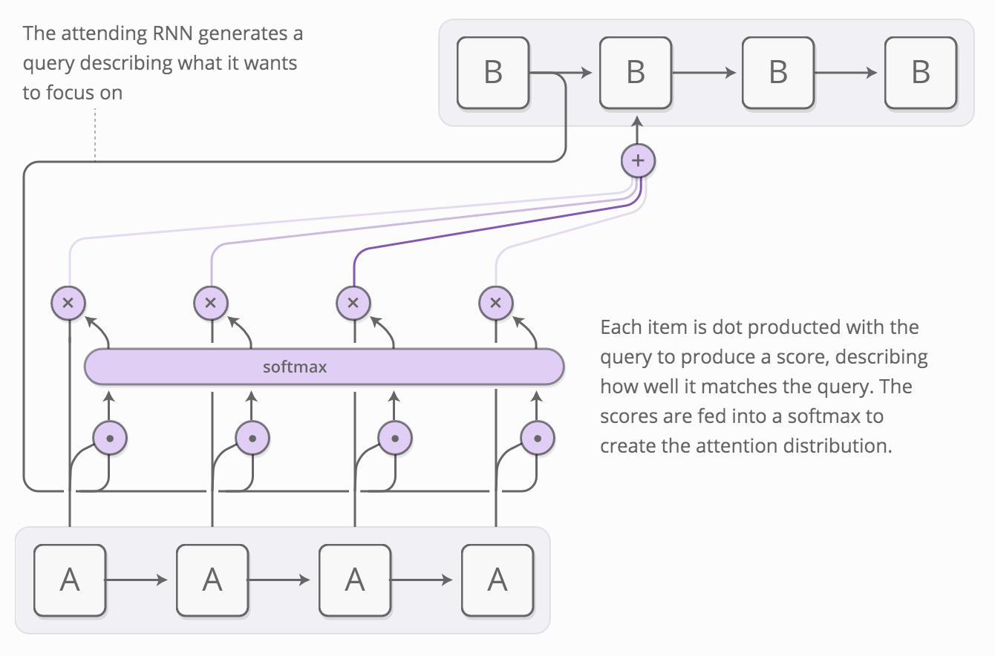
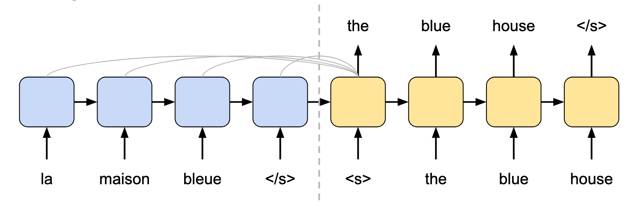
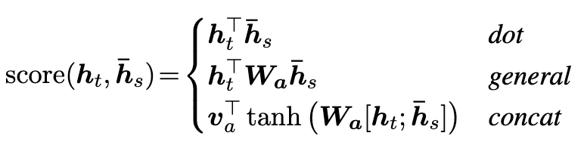
Encoder/Decoder RNN Architecture with Attention
Attention mechanism calculates ‘context vector’ for each decoding step, ‘attending’ to all encoder outputs
Note: there are multiple approaches to calculate attention scores. See for example https://www-nlp.stanford.edu/pubs/emnlp15_attn.pdf:
Final Encoder RNN output initializes Decoder RNN

Slide 9
Revisiting LMs and Transfer Learning (2 weeks ago)

Slide 10

LSTMs in LM Architectures: Training
Desired Output (Labels)
like this book
Softmax
Softmax
Softmax
FCC/Affine Layer + Softmax
(FCC +) Affine Layer
(FCC +) Affine Layer
(FCC +) Affine Layer
One or more LSTM layers
Input (w/ Embedding)
I like this book

Slide 11
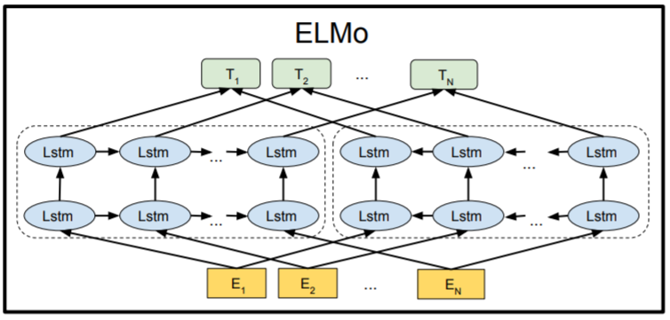
Introducing ELMo
Paper with deep insight: ”Deep contextualized word representations”, Peters et al, https://arxiv.org/pdf/1802.05365.pdf
Word vectors with context!
Bi-directional LSTM architecture, trained on 1bn+ word corpus on LM task
Final forward/backward vectors are concatenated
Model also returns output for intermediate layers
Image Source: ”BERT: Pre-training of Deep Bidirectional Transformers for Language Understanding”, Devlin et al, https://arxiv.org/pdf/1810.04805.pdf
Notes:
Talk through the architecture. Details of initial word-embeddings from running a CNN over character-level embeddings not crucial here.

Slide 12
Can attention improve language model based transfer learning?

Slide 13
Week 9: Self-Attention & Transfer Learning

Slide 14
The Transformer Architecture

Slide 15
Brainstorming/Thought Process: “How Can We ‘Solve’ the Sequential Issue in RNNs”
What makes this slow?
la
maison
bleue

Slide 16
Brainstorming/Thought Process: “How Can We ‘Solve’ the Sequential Issue in RNNs”
What do the cell states actually ‘do’?
la
maison
bleue

Slide 17
Brainstorming/Thought Process: “How Can We ‘Solve’ the Sequential Issue in RNNs”
Providing the context for the current calculation. In other words… the calculation for ‘bleue’ needs a way to refer (back) to (previous) words. Have we seen another mechanism that does something like this before?”
la
maison
bleue

Slide 18
Brainstorming/Thought Process: “How Can We ‘Solve’ the Sequential Issue in RNNs”
Yes, Attention!!
“ ~ ”
x
x
la
maison
bleue
la
maison
bleue

Slide 19
Brainstorming/Thought Process: “How Can We ‘Solve’ the Sequential Issue in RNNs”
Why could that be better for computational purposes?
“ ~ ”
x
x
la
maison
bleue
la
maison
bleue

Slide 20
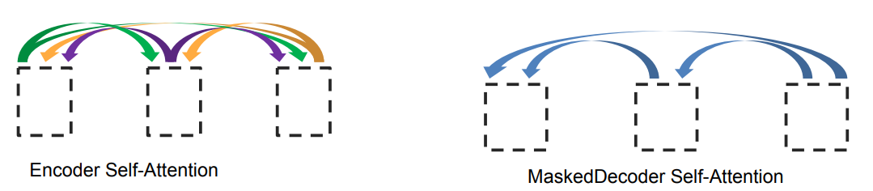
Attention is All You Need (Vaswani et al. 2017)
What if we replaced the entire RNN with self-attention?
Repeated self-attention layers for encoder
Decoder uses masked self-attention for sequential output
Sinusoidal timing signal to distinguish position
Graphic from Lukasz Kaiser: https://nlp.stanford.edu/seminar/details/lkaiser.pdf
Notes:
See https://research.googleblog.com/2017/08/transformer-novel-neural-network.html and Vaswani et al. 2017

Slide 21
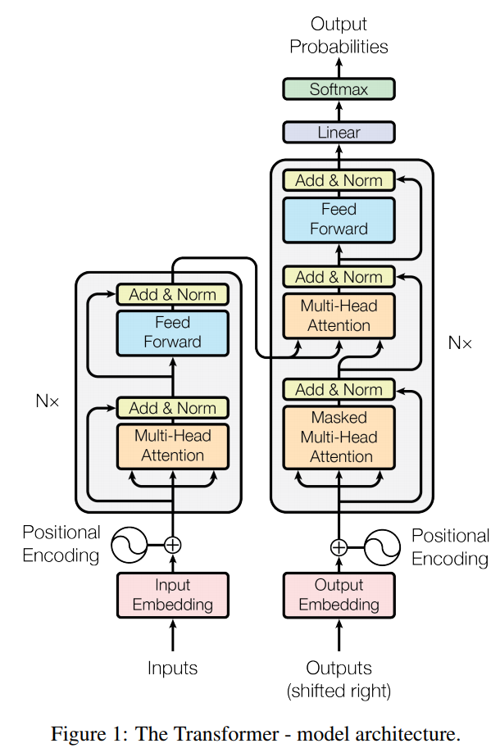

Attention is All You Need
From Vaswani et al. 2017 and https://research.googleblog.com/2017/08/transformer-novel-neural-network.html
Notes:
h1 = xW1 + b1
h2 = h1W2 + b2 = (xW1 + b1)W2 + b2
h2 = x(W1W2) + (b1W2 + b2)

Slide 22
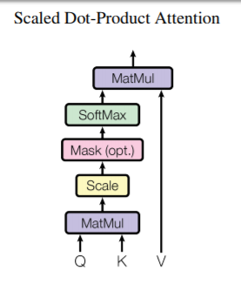
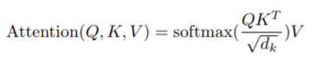
Going One Level Deeper
Q: ‘Query’, derived from ‘word/vector under consideration’, combined into matrix K: ‘Keys’, derived for ‘all words/vectors in sentence/segment’ (as matrix) V: ‘Values’, derived for ‘all words/vectors in sentence/segment’ (as matrix)
Notes:
Q = la = [0.1, 0.2]
the = [0.3, 0.4] boy [0.5, 0.6] fell [0.7, 0.8]
K = [[0.3, 0.4], [0.5, 0.6], [0.7, 0.8]]
transpose(K) = [[0.3, 0,5, 0.7], [0.4, 0.6, 0.8]]
Q * K = not even possible
Q * transpose(K) = [0.11, ]
V = K

Slide 23
Self-Attention (Simplified!, 1-Layer)
Q₁ K₁ V₁ Q₂ K₂ V₂ Q₃ K₃ V₃ Q₄ K₄ V₄ Q₅ K₅ V₅
‘This’ ‘house’ ‘is’ ‘now’ ‘blue’
Sentence
Notes:
Self Attention example (appendix)

Slide 24
Self-Attention (Simplified!, 1-Layer)
Q₁ K₁ V₁ Q₂ K₂ V₂ Q₃ K₃ V₃ Q₄ K₄ V₄ Q₅ K₅ V₅
‘This’ ‘house’ ‘is’ ‘now’ ‘blue’
1
-2
2
2
7
Embedding E (from Token + Position)
12
-5
2
1
-1
3
3
-2
-2
12
-1
3
7
-6
3
Sentence
Notes:
Self Attention example (appendix)

Slide 25
Self-Attention (Simplified!, 1-Layer)
Q₁ K₁ V₁ Q₂ K₂ V₂ Q₃ K₃ V₃ Q₄ K₄ V₄ Q₅ K₅ V₅
‘This’ ‘house’ ‘is’ ‘now’ ‘blue’
Queries, Keys, Values (E x W^{Q}, E x W^{K}, …)
1
-1
3
2
1
-1
4
-2
2
4
-1
2
2
2
-2
1
3
-1
-1
1
-1
1
-4
4
2
1
-4
-5
1
1
1
-2
2
2
7
Embedding E (from Token + Position)
12
-5
2
1
-1
3
3
-2
-2
12
-1
3
7
-6
3
Sentence
Notes:
Self Attention example (appendix)

Slide 26
Self-Attention (Simplified!, 1-Layer)
Self-Attention Vectors
Q₂ K₁ = -5
Q₂ K₂ = 1
Q₁ K₁ V₁ Q₂ K₂ V₂ Q₃ K₃ V₃ Q₄ K₄ V₄ Q₅ K₅ V₅
‘This’ ‘house’ ‘is’ ‘now’ ‘blue’
Q₂ K₃ = 0
Q₂ K₄ = -3
Q₂ K₅ = 3
Queries, Keys, Values (E x W^{Q}, E x W^{K}, …)
1
-1
3
2
1
-1
4
-2
2
4
-1
2
2
2
-2
1
3
-1
-1
1
-1
1
-4
4
2
1
-4
-5
1
1
1
-2
2
2
7
Embedding E (from Token + Position)
12
-5
2
1
-1
3
3
-2
-2
12
-1
3
7
-6
3
Sentence
Notes:
Self Attention example (appendix)

Slide 27
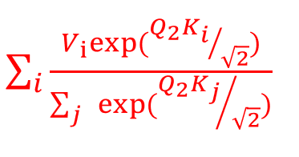
Self-Attention (Simplified!, 1-Layer)
Self-Attention Vectors
-1.4
SA₂ = =
0.85
Q₂ K₁ = -5
Q₂ K₂ = 1
Q₁ K₁ V₁ Q₂ K₂ V₂ Q₃ K₃ V₃ Q₄ K₄ V₄ Q₅ K₅ V₅
‘This’ ‘house’ ‘is’ ‘now’ ‘blue’
Q₂ K₃ = 0
Q₂ K₄ = -3
Q₂ K₅ = 3
Queries, Keys, Values (E x W^{Q}, E x W^{K}, …)
1
-1
3
2
1
-1
4
-2
2
4
-1
2
2
2
-2
1
3
-1
-1
1
-1
1
-4
4
2
1
-4
-5
1
1
1
-2
2
2
7
Embedding E (from Token + Position)
12
-5
2
1
-1
3
3
-2
-2
12
-1
3
7
-6
3
Sentence
Notes:
Self Attention example (appendix)

Slide 28

The Transformer Architecture
Image Source & excellent blog: http://jalammar.github.io/illustrated-transformer /
Notes:
More Transformer Architecture (appendix)

Slide 29
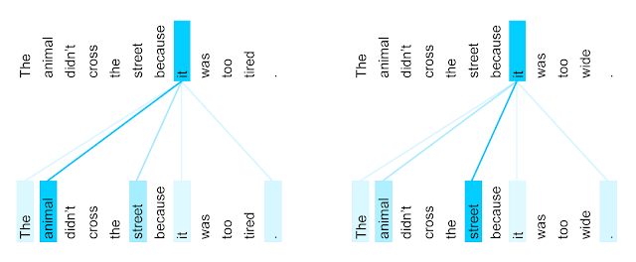
Attention is All You Need
Winograd schema: coreference examples
Look at en -> fr where coref needed for correct translation
Attention head learns to pick the correct antecedent!
Notes:
More Transformer Architecture (appendix)

Slide 30
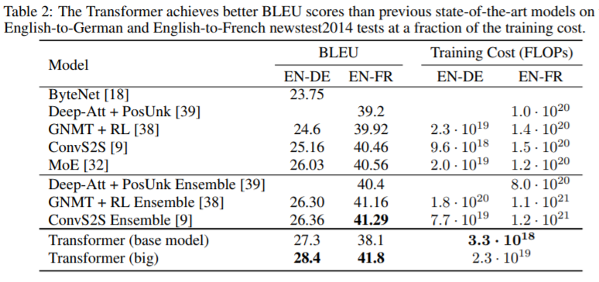
Comments
Encoder output is fed into Decoder through 2nd attention function in Decoder (Q from Decoder, K,V from encoder)
Masking is used on Decoder so that Decoder does not peek ahead
No more ‘one-step at a time’ (during training)!
~100x faster than RNN approach for MT
From Vaswani et al. 2017

Slide 31
Transfer Learning

Slide 32
Transfer Learning
Problem: “Can we create one generalized model for all NLP tasks?”
Multi-task Learning: train on multiple tasks and share weights so performance on each task improves Natural Language Processing (almost) from Scratch (Collobert et al., 2011)
Transfer Learning: train a model on a general task that will help on multiple linguistic problems then fine tune that model for your specific problem
Zero Shot: model performs a task it has never seen which implies good model generalization.
One (few) Shot: model performs a task after only seeing it once (few times) (GPT-3)

Slide 33
An Architectural Example
Can ELMO do anything on its own?
ELMO pre-trained on language modeling task
Needs model above to actually do something (classify, NER, etc.)
How does your model learn?
Train your model above AND (usually) ELMO weights
? ? ? ? ?
Image Source: ”BERT: Pre-training of Deep Bidirectional Transformers for Language Understanding”, Devlin et al, ,https://arxiv.org/pdf/1810.04805.pdf
Notes:
Illustrate the role of pre-training and fine tuning in transfer learning.

Slide 34
Pre-Training and Fine-Tuning
Pre-training
Learn one or more tasks that provide a foundation for performing other tasks
Predict next word
Predict missing word(s)
Are sentences connected?
Fine-tuning
Add a layer(s) on top that performs your specific task like classification or span identification.
Use your small domain specific training set to train your model to make accurate predictions

Slide 35
Pre-trained Models:
BERT, GPT & T5

Slide 36
BERT
Bidirectional Encoder Representations from Transformers (available on TensorFlow Hub and Hugging Face)
Notes:
BERT en

Slide 37
BERT Dimensions
Transformer Encoder Architecture:
Input up to 512 tokens
BERT Base in 12 encoder layers, BERT Large is 24 encoder layers
BERT Base in 12 attention heads, BERT Large is 16 attention heads
Each output token is 768 dimension vector for BERT Base and 1024 dimension vector to BERT Large

Slide 38
BERT Pre-Training Details
Model pre-trained on <Tasks> and <Corpora>
Tasks = Masked Language Model and Next Sentence Prediction
Corpora = Books Corpus and Wikipedia
Currently provide cased, uncased, base, large and multilingual models

Slide 39
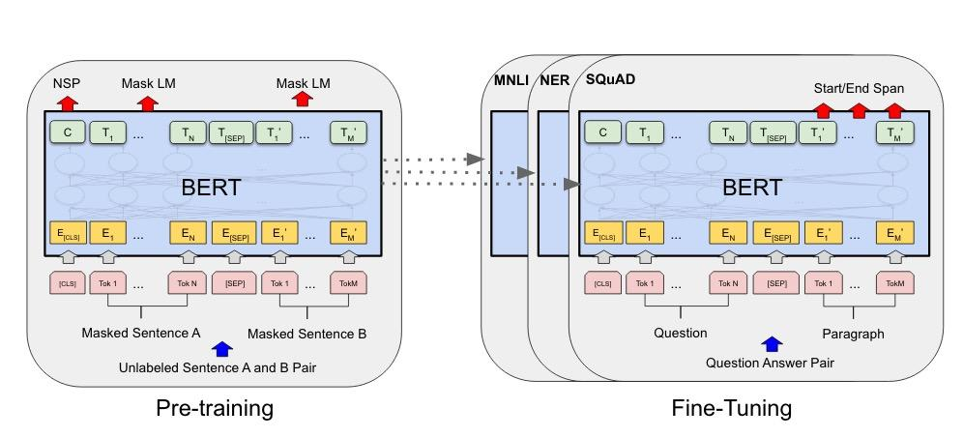
Pre-Training and Fine Tuning
Image Source: ”BERT: Pre-training of Deep Bidirectional Transformers for Language Understanding”, Devlin et al, ,https://arxiv.org/pdf/1810.04805.pdf

Slide 40
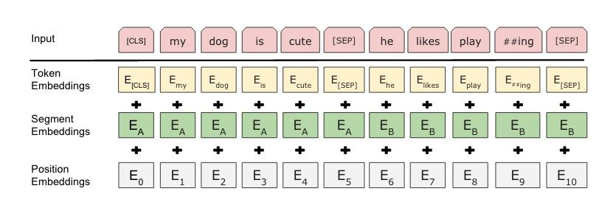
BERT Sequential Input & Word Pieces
Vocab size is ~30,000 because of word pieces (WordPiece) (embedding process)
Token embedding is lookup to learned word piece embedding
Segment and Position embedding maintains sequence information
Be sure to use the right tokenizer!
Image Source: ”BERT: Pre-training of Deep Bidirectional Transformers for Language Understanding”, Devlin et al, ,https://arxiv.org/pdf/1810.04805.pdf

Slide 41
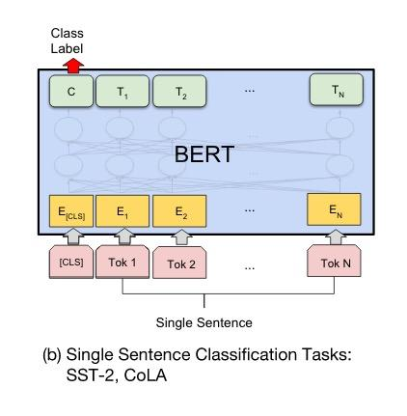
Classification Task
Single sentence input
Take output vector from CLS position
Create feed forward network with affine and sigmoid to classify
Fine tune to learn specific classification labels
Image Source: ”BERT: Pre-training of Deep Bidirectional Transformers for Language Understanding”, Devlin et al, ,https://arxiv.org/pdf/1810.04805.pdf

Slide 42
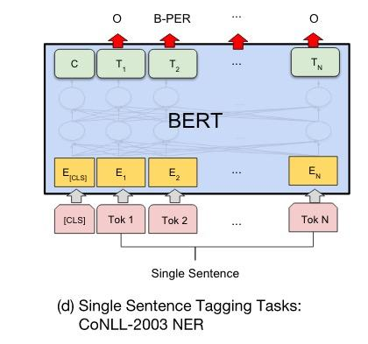
Named Entity Recognition
Feature-based approach too
Take output vectors as embeddings
Predict optimal BIO label sequence
96.1 F1 score using last 4 hidden layers concatenated
96.6 F1 score with fine tuning on BERT Large
Image Source: ”BERT: Pre-training of Deep Bidirectional Transformers for Language Understanding”, Devlin et al, ,https://arxiv.org/pdf/1810.04805v1.pdf

Slide 43
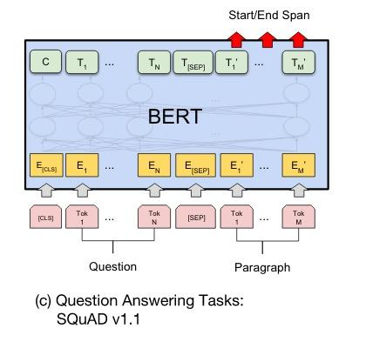
Question Answering
Question and Answer passage input with separator
Take output vectors from answer passage tokens
Create feed forward network with affine and softmax over output tokens to predict most likely start end span
Image Source: ”BERT: Pre-training of Deep Bidirectional Transformers for Language Understanding”, Devlin et al, ,https://arxiv.org/pdf/1810.04805.pdf

Slide 44
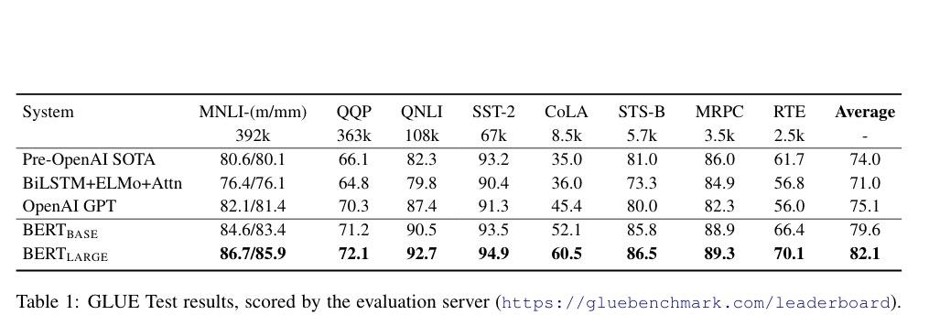
Transfer Learning Effectiveness
Image Source: ”BERT: Pre-training of Deep Bidirectional Transformers for Language Understanding”, Devlin et al, ,https://arxiv.org/pdf/1810.04805.pdf

Slide 45
Paper Peek
-> A Primer in BERTology: What we know about how BERT works<-
Notes:
Excellent literature survey of rapidly changing field

Slide 46
BERT Variants
Vary by task AND/OR vary by domain:
BioBert/ClinicalBERT / SciBERT - BERT model pre-trained on Biomedical papers or clinical notes or scientific literature
RoBERTa - BERT with “better” masking task and more epochs of training
DistilBERT - small retrained model based on student teacher approach
MobileBERT - small retrained model designed to run on Pixel 4 phone
FlauBERT - BERT trained solely on French texts
SpanBERT - BERT tuned to predict entire contents of masked span
Also transformer variants like Transformer-XL and Longformer and BigBird
FireBERT - BERT hardened to adversarial examples (by w266 MIDS students Spring 2020) Accepted at the Future of Communications Conference (FICC) 2021
Notes:
Many BERT variants and number grows weekly. Is there a BERT variant suitable for your project?

Slide 47
BERT colab notebook for experimentation
PUBLIC: Colab Notebook for classification of movie reviews
GIT NER: https://github.com/datasci-w266/2021-spring-main/blob/master/materials/Bert/BERT_T5_NER_2_3_030121.ipynb

Slide 48
GPT
Generative Pre-Training (available on HuggingFace!)

Slide 49
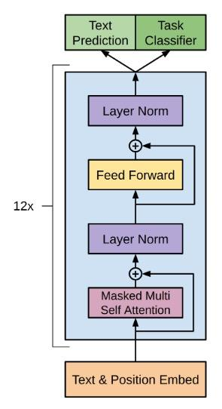
GPT Structure
Same architecture as BERT, but: LM trained to predict next word based on last 512 window
Model details:
12 Stacked Decoder Blocks
12 attention heads and 768 dimension vectors
Trained with Book Corpus - long contiguous runs of text
Structure input with delimiters
Fine tune with affine and non-linearity to learn specific classification labels
Image Source: ”Improving Language Understanding by Generative Pre-Training”, Radford et al, ,https://openai.org/paper

Slide 50
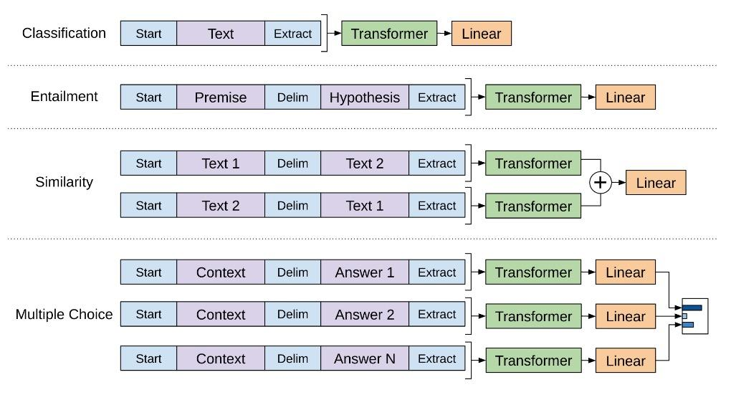
GPT Task Structures
Image Source: ”Improving Language Understanding by Generative Pre-Training”, Radford et al, ,https://openai.org/gpt-paper

Slide 51
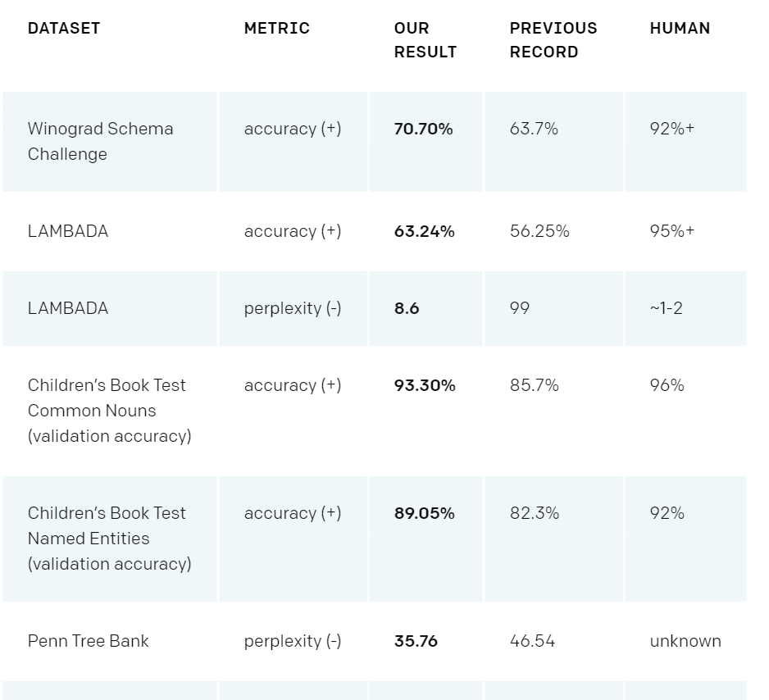
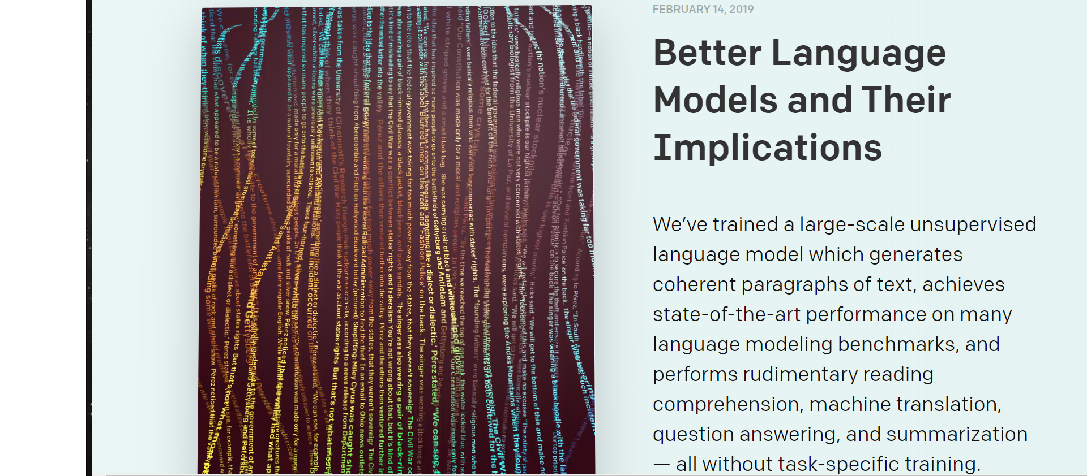
GPT-2 Unsupervised Transfer
https://blog.openai.com/better-language-models/
… and more

Slide 52
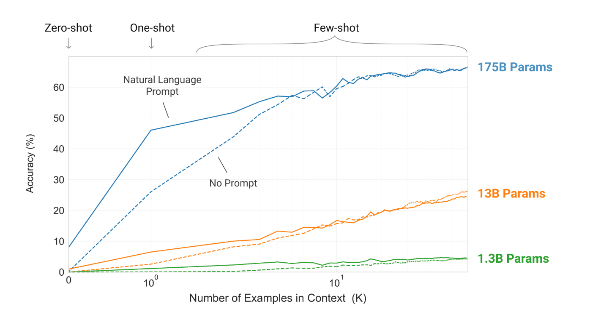
‘Warm-ish’ Off The Press: Open AI’s GPT-3 “Language Models are Few-Shot Learners”
Huge Language Model - 175 bn parameters
Excellent Few-Shot performance for many tasks - with no gradient updates!
Still some surprising limitations in various critical tasks like language inference:
Source Paper: https://arxiv.org/pdf/2005.14165.pdf

Slide 53
T5
’Text-to-Text Transfer Transformer’ (available on HuggingFace)

Slide 54
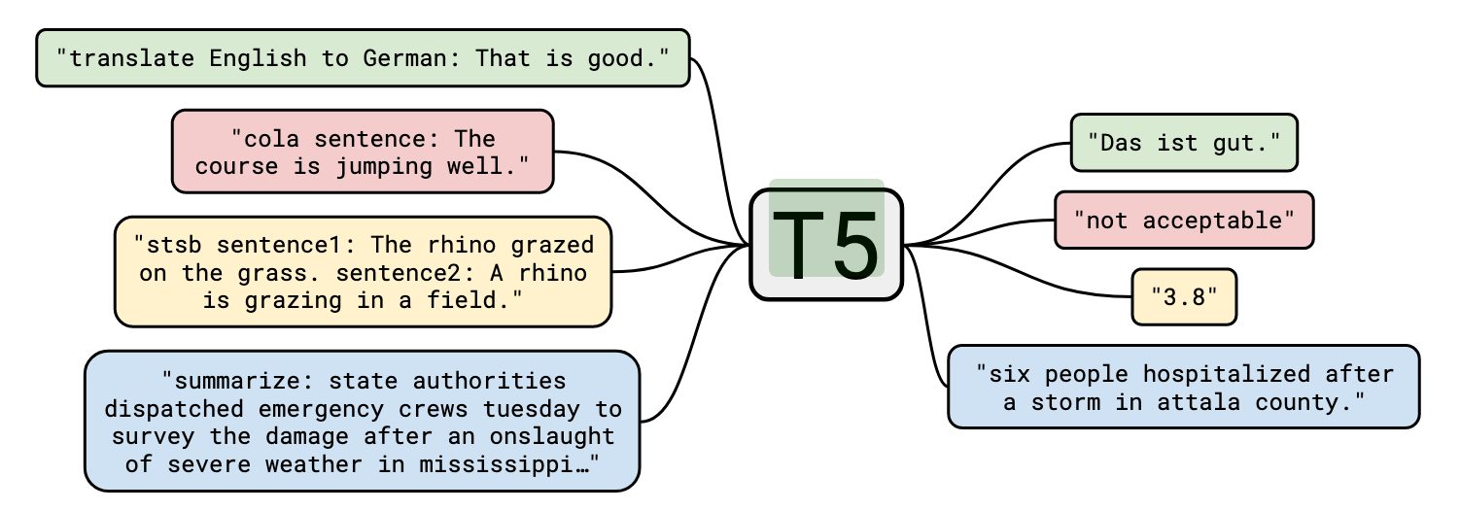
T5 Structure
Pre-trained Encoder + Decoder transformer architecture
Pre-trained on multiple tasks:
Pre-trained on Colossal Clean Crawl Corpus’ with generic task
Fine-tuned on various GLUE/SuperGLUE tasks
Available Sizes (at HuggingFace)
Small
Base
Large
3GB
11GB
+ MANY customized fine-tuned models (https://huggingface.co/models)
Source: ”Exploring the Limits of Transfer Learning with a Unified Text-to-Text Transformer”, Raffel et al, https://arxiv.org/pdf/1910.10683.pdf

Slide 55
Implementations:
Hugging Face & TensorFlow Hub

Slide 56
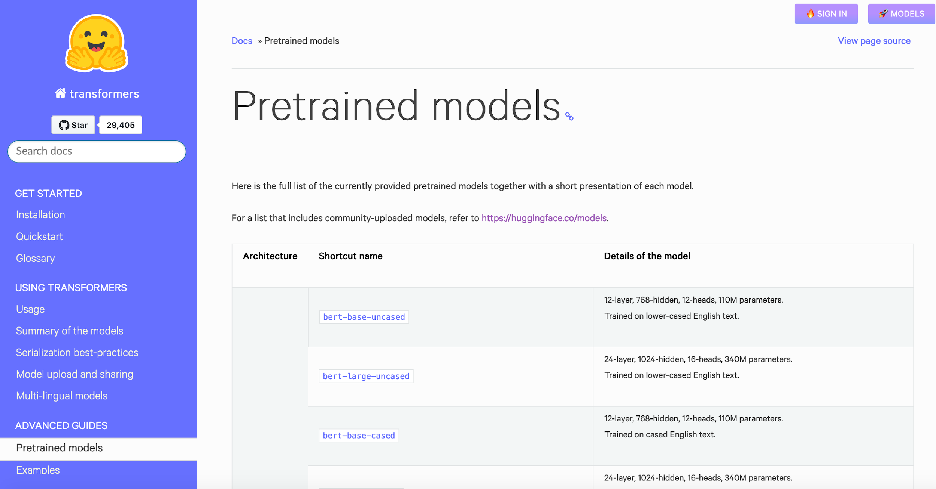
Hugging Face Transformer Implementations
Open-source framework with consistent Transformer implementations in PyTorch and TensorFlow. (I.e., easy to swap models!)
Many models, and constantly updated:
BERT & Variants
GPT
XLNet
CTRL
Longformer
Electra
T5
….

Slide 57
Hugging Face Transformer Implementations
How to get it?
Go to https://huggingface.co/transformers/ to learn
Install transformer library (‘pip install transformers’)
In notebook/code, Import tokenizer and model
Get going!
Let’s try it...
https://github.com/datasci-w266/2021-spring-main/blob/master/materials/lesson_notebooks/lesson_8.ipynb

Slide 58

TensorFlow Hub
Similar in spirit - repo for lots of models, also beyond transformers
Location: https://tfhub.dev/
No source code, But broader set of models.

Slide 59
Appendix

Slide 60
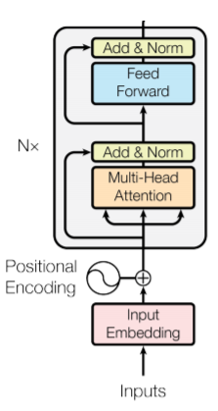
Going One Level Deeper: Encoder Flow
W^{Q/K/V}: h learned projections matrices projecting to d/h dimension
Q_{(i)} = X W^{Q}_{(i)}
X K_{(i)} = X W^{K}_{(i)}
V_{(i)} = X W^{V}_{(i)}
head_{(i)} = softmax(Q_{(i)} K_{(i)})V_{(i)}
A = concat(head_{1,..} ) W^{O}
Y = Norm (X + A)
W^{O}: learned projection matrix ensuring proper final dim
F = max(0, Y W₁ + b₁)W₂ + b₂
Z = Norm(F + Y)
X, Z: Same Dimensions! Z is input for next layer
W_{1/2}, b_{1/2} : weights & biases for fully connected layer

Slide 61
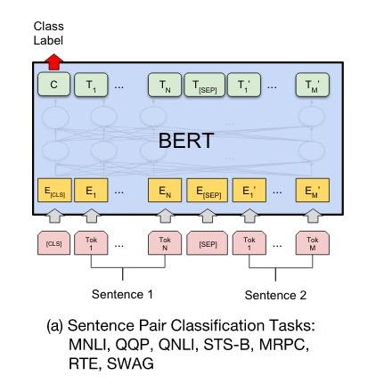
Sentence Pair Classification
Sentence pair input with separator
Take output vector from CLS position
Create feed forward network with affine and sigmoid to classify
Fine tune to learn specific classification labels
Image Source: ”BERT: Pre-training of Deep Bidirectional Transformers for Language Understanding”, Devlin et al, ,https://arxiv.org/pdf/1810.04805.pdf

Slide 62
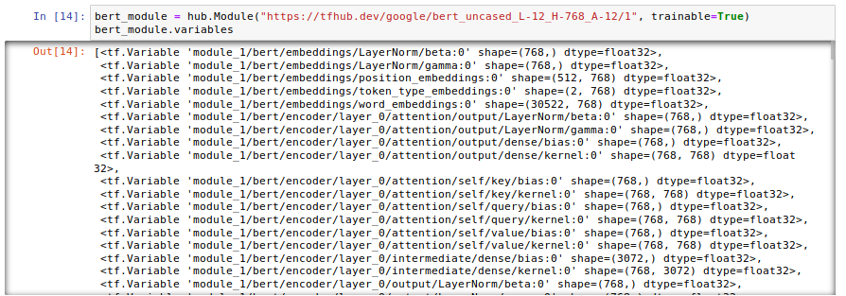
BERT Comments
Bert Variables - can be used for fine-tuning some of the layers:

Slide 63
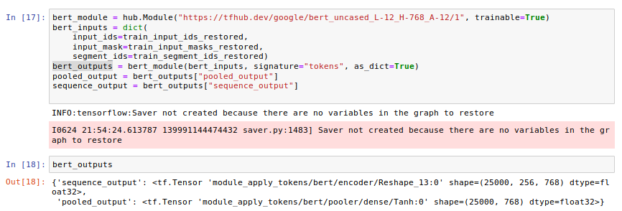
BERT Comments
Bert Outputs: pooled & sequence
One output vector per token (256: max length in example)

Slide 64
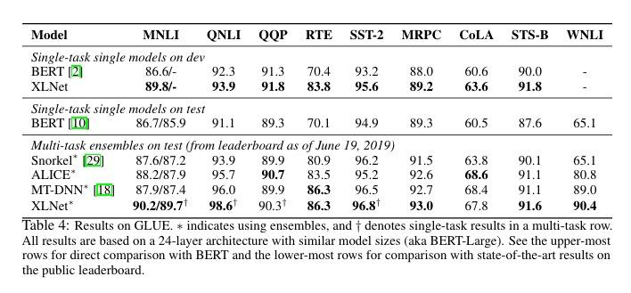
XLNet
Key Insight: Randomly permuted sequence factorization.
Transformer-XL more context!
Much more training data: Wikipedia and BooksCorpus, plus Giga5, ClueWeb, and Common Crawl.
BERT models from Devlin et al., (2018) use only Wikipedia and BooksCorpus.
Image Source: ”XLNet: Generalized Autoregressive Pretrainingfor Language Understanding”, Yang et al, ,Enhanced LM - XLNet

Slide 65
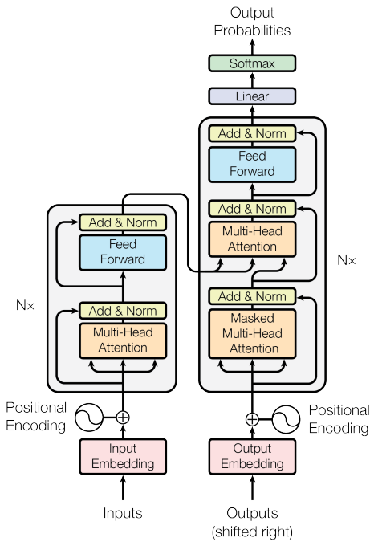
Attention is all you need
NeuroIPS 2017 Vaswani, et al introduced the transformer architecture using Multi-Head Attention

Slide 66

Self-Attention (Another example)

Slide 67
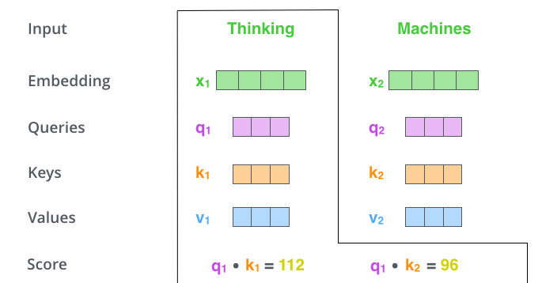
Self-Attention (Another example)

Slide 68
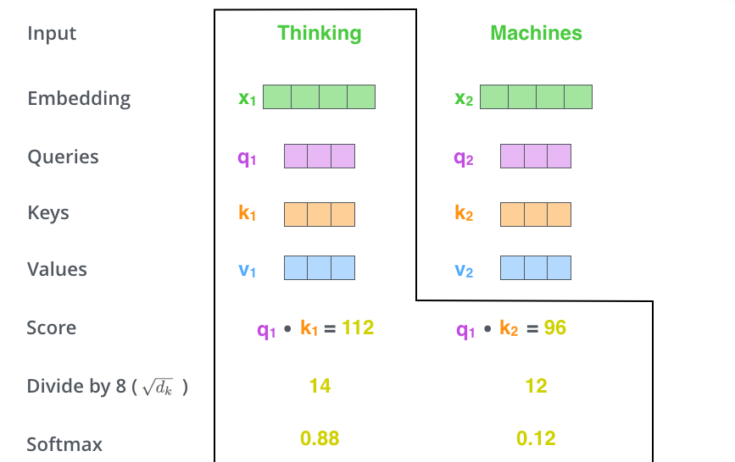
Self-Attention (Another example)

Slide 69

Self-Attention (Another example)

Slide 70

The Transformer Architecture
Image Source:http://jalammar.github.io/illustrated-transformer/

Slide 71

The Transformer Architecture
Image Source:http://jalammar.github.io/illustrated-transformer/

Slide 72

The Transformer Architecture
Image Source: jalammer.github.io/illustrated-bert

Slide 73
The Transformer Architecture
Image Source:http://jalammar.github.io/illustrated-transformer/

Slide 74

Multi-Head Attention
Image Source:http://jalammar.github.io/illustrated-transformer/

Slide 75

Multi-Head Attention
Image Source:http://jalammar.github.io/illustrated-transformer/

Slide 76
Multi-Head Attention
Image Source:http://jalammar.github.io/illustrated-transformer/

Slide 77

Attention with Decoders
Image Source: jalammer.github.io/illustrated-bert

Slide 78

Full Transformer
Image Source:http://jalammar.github.io/illustrated-transformer/

Slide 79

Full Transformer
Image Source:http://jalammar.github.io/illustrated-transformer/

Slide 80
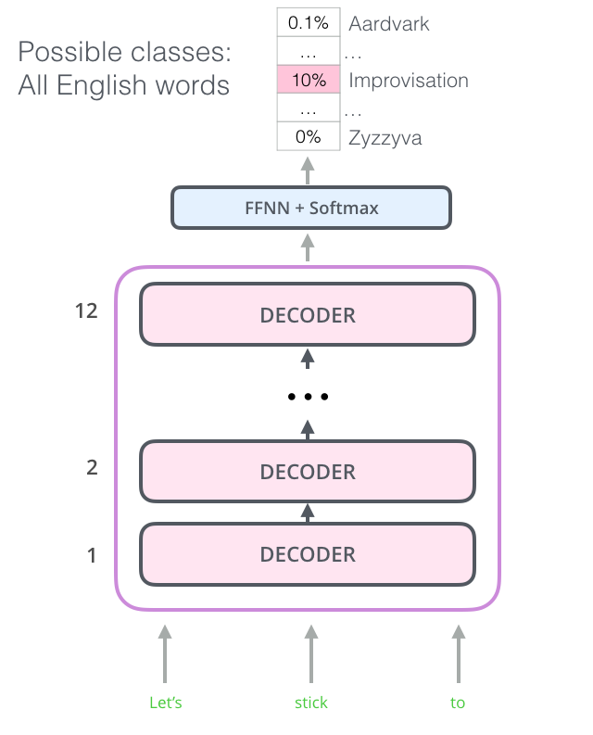
Open AI’s GPT-1
GPT-1 uses the decoder side
12 stacked decoders with masked “next words” and using MHA self-attention
Image Source: jalammer.github.io/illustrated-bert

Slide 81
Open AI’s GPT-1
Image Source: jalammer.github.io/illustrated-bert

Slide 82
Open AI’s GPT-1
Image Source: jalammer.github.io/illustrated-bert

Slide 83
Open AI’s GPT-1
Image Source: jalammer.github.io/illustrated-bert

Slide 84
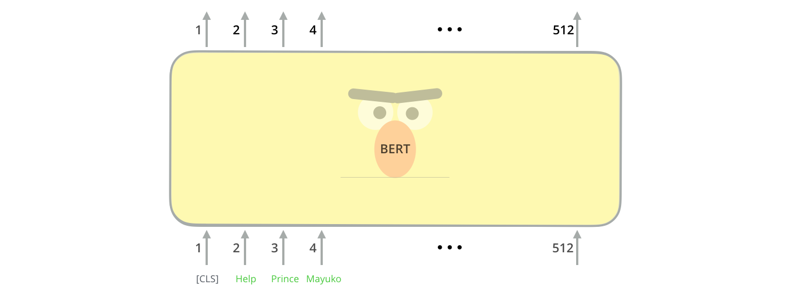
BERT vs GPT-1
Instead of masking the “next word” BERT masks words randomly (12%) in the sentence.
Image Source: jalammer.github.io/illustrated-bert

Slide 85
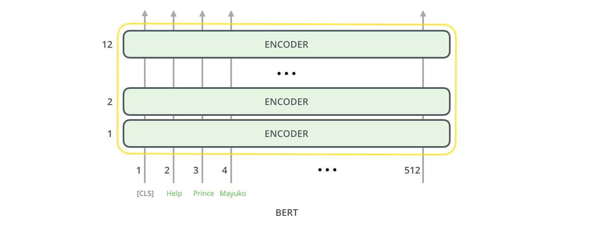
BERT vs GPT-1
Everything can run on the Encoder side of the transformer architecture.
Image Source: jalammer.github.io/illustrated-bert

Slide 86
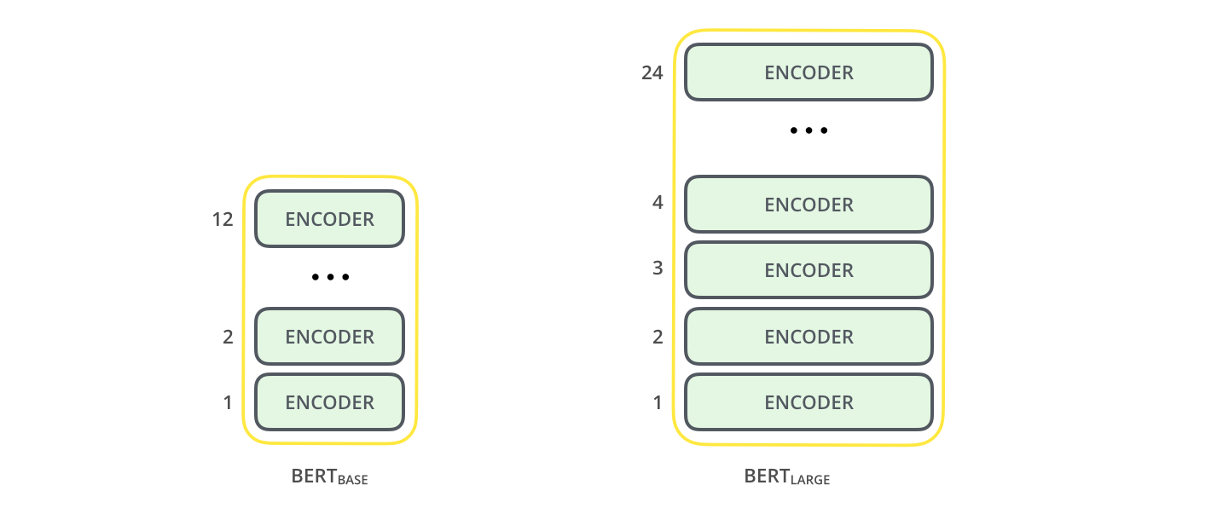
BERT and BIG BERT
BERT_{BASE}: 760 units and 12 encoders (compete with GPT-1)
BERT_{BIG}: 1024 units and 24 encoders
Image Source: jalammer.github.io/illustrated-bert

Slide 87
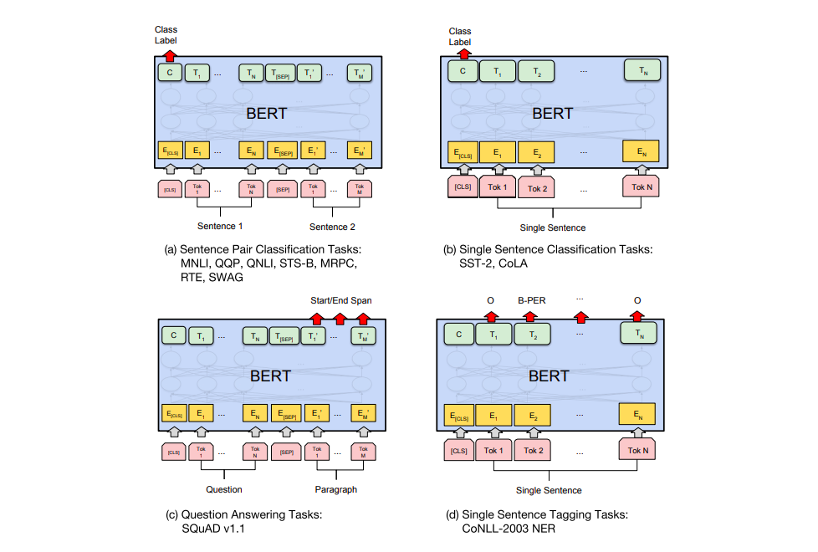
BERT Tasks
Image Source: jalammer.github.io/illustrated-bert

Slide 88
Zero Shot Translation

Slide 89
Multilingual NMT (Johnson et al. 2016)
Train a single model on many language pairs (many to many)
Train with special target token:
Comí la comida. <2en> I ate the food.
W266 is my favorite class ! <2fr> W266 est ma classe préférée.
Shared vocabulary using word-pieces (Schuster and Nakajima 2012):
Words: Jet makers feud over seat width with big orders at stake
Wordpieces: _J et _makers _fe ud _over _seat _width _with _big _orders _at _stake
Notes:
Also related, some prior work by our very own Dan Gillick, with a similar style of multilingual model for NER: https://arxiv.org/pdf/1512.00103.pdf

Slide 90
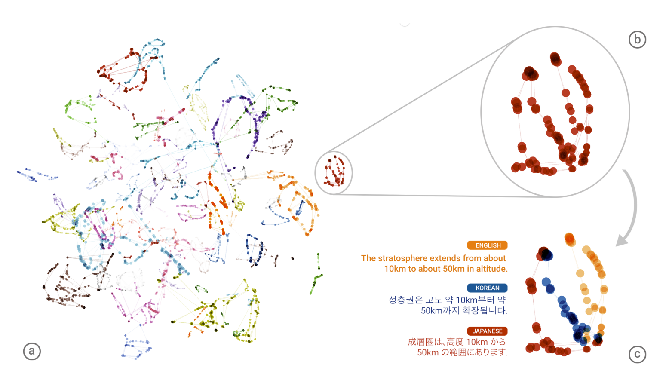
Multilingual NMT: Evidence of Interlingua
Single model:
en -> ja
ja -> en
en -> ko
ko -> en
Figure 2 of Johnson et al. 2016

Slide 91
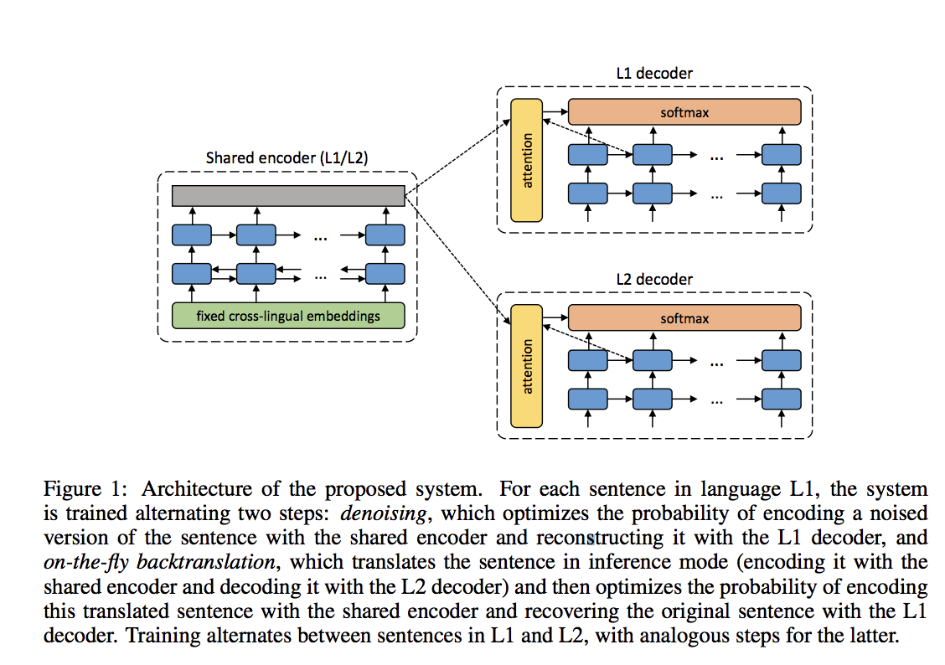
Monolingual Training
Unsupervised Neural Machine Translation (Artetxe et al. 2018)

Slide 92
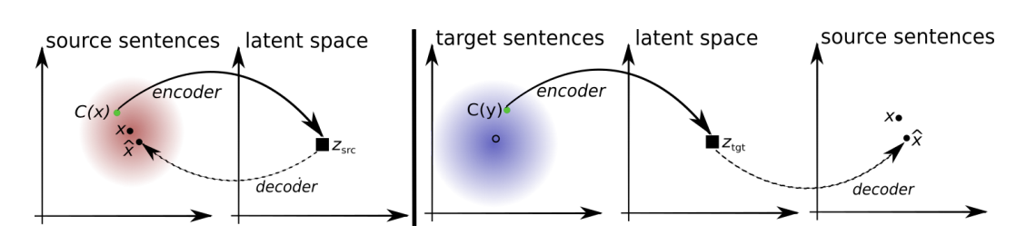
Monolingual Training
Unsupervised Machine Translation using Monolingual Corpora Only (Lample et al. 2018)

Slide 93
Convolutional Neural Networks

Slide 94

https://developer.apple.com/library/content/documentation/Performance/Conceptual/vImage/ConvolutionOperations/ConvolutionOperations.html

Slide 95
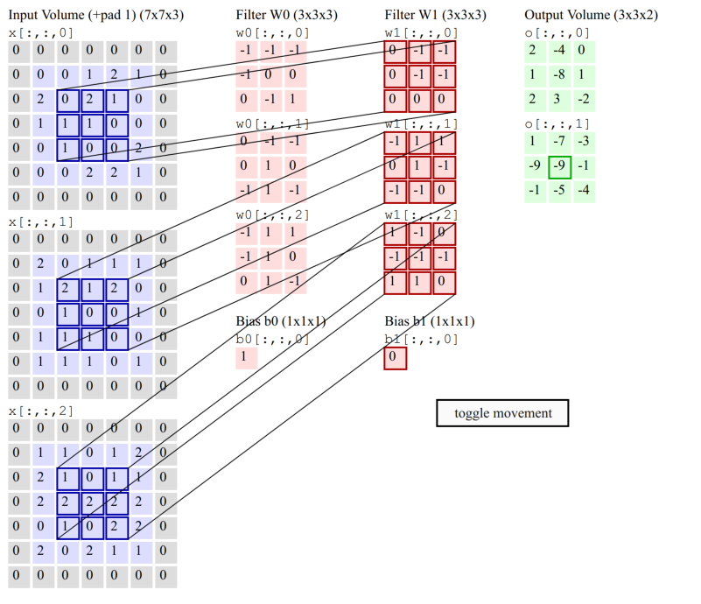

Slide 96
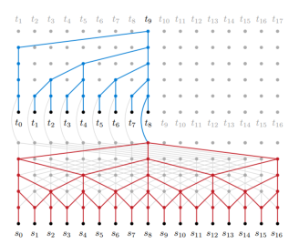
ByteNet: Convolution over characters
Neural Machine Translation in Linear* Time, Kalchbrenner et al, March 2017
Notes:
(It’s not really linear - you need depth proportional to log(n) )

Slide 97
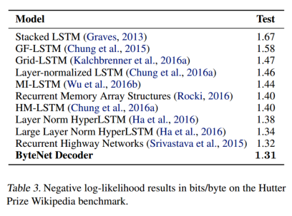
ByteNet: Language Model

Slide 98
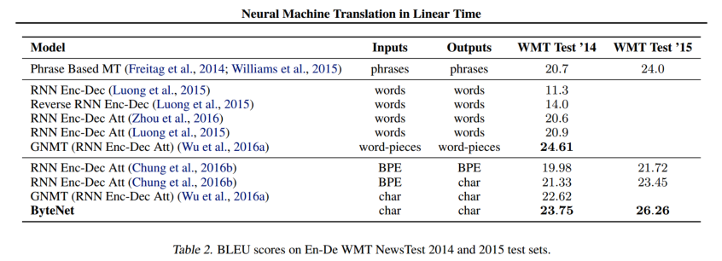
ByteNet: Translation Model

Slide 99
Word Alignments: Cross-Lingual Parsing

Slide 100
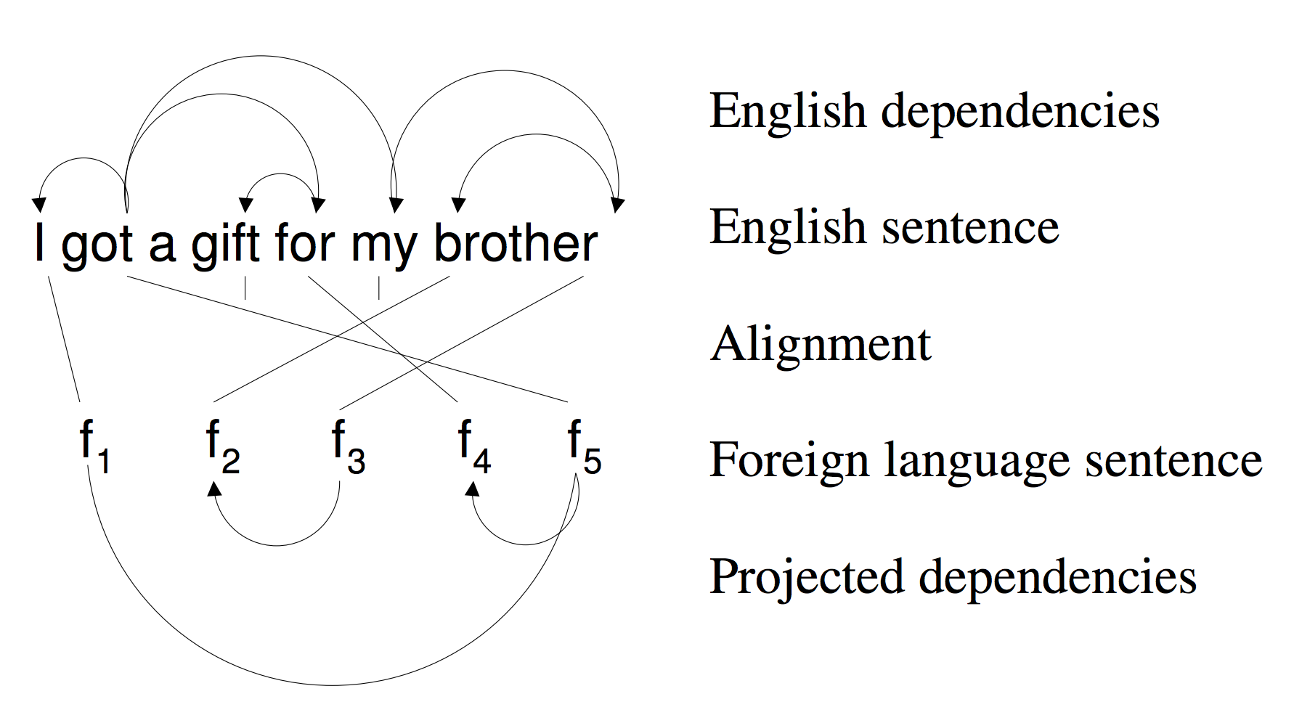
Cross-Lingual Parsing
Neural MT doesn’t need explicit alignment model.
But: alignments useful for domain transfer!
Input: English parser
Input: parallel sentences (f, e)
Output: parsed foreign sentences
Source: “Bootstrapping Parsers via Syntactic Projection across Parallel Texts” (Hwa et al. 2005)

Slide 101
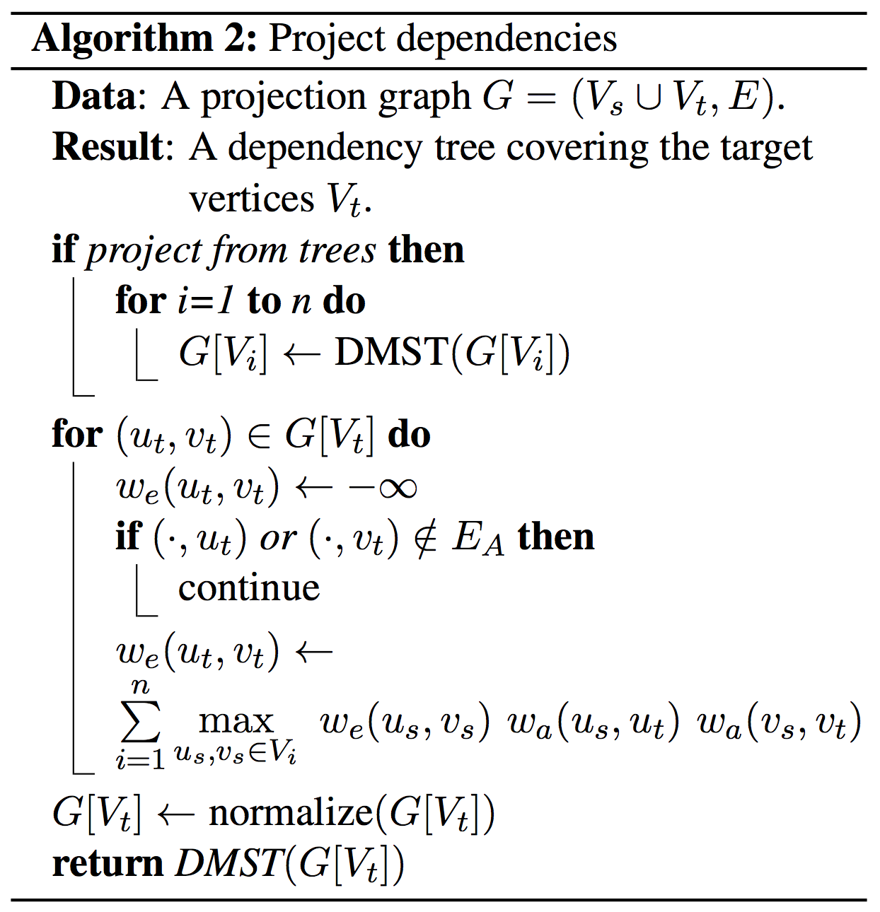
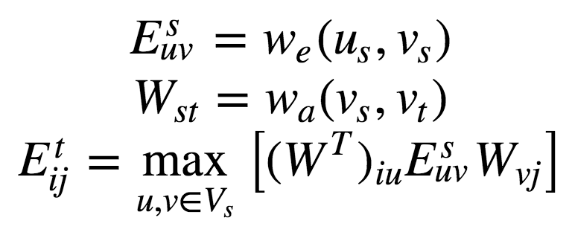
Cross-Lingual Parsing
(almost) Equivalent to matrix multiplication:
If interested in typed edges, can treat E as 3rd-rank tensor
Normalize columns of E^{t}, then DMST to decode
Source: Multilingual Projection for Parsing Truly Low-Resource Languages (Agic, et al. 2016)

Slide 102
Better models?

Slide 103
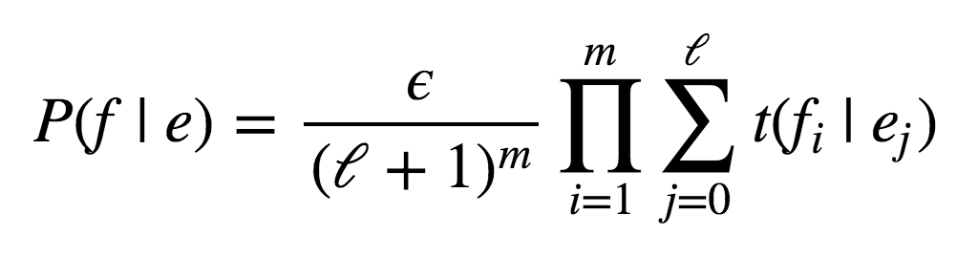
Model 1 Limitations
Bag-of-words model! (yuck)
P(f | e) doesn’t depend on order of sequence e
Thus, P(e | f) relies on LM P(e) for fluency
Problems?
Alignments all independent
No many-to-one alignments, or many-to-many
Problems?
Word-factored - problems?

Slide 104
Model 1 vs. Model 2
Model 1: “bag of words”
Generative process e → f with P(f | e)
Sample a length m ∼ Q(m)
Distribution Q(m) doesn’t matter!
Sample an alignment {a_{i}} for i = 1,...,m
a_{i} ∼ Uniform(0, ℓ + 1)
a_{i} independent
Sample a word f_{i} from t(f | e_{ai})
t(f | e) tabulated
Model 2: distortion probabilities
Generative process e → f with P(f | e)
Sample a length m ∼ Q(m)
Distribution Q(m) doesn’t matter!
Sample an alignment {a_{i}} for i = 1,...,m
a_{i} ∼ a(a_{i}| i, ℓ, m)
a_{i} independent
Sample a word f_{i} from t(f | e_{ai})
t(f | e) tabulated
Notes:
Note: often train Model 1 and use the translation probabilities t(f | e) to initialize a more sophisticated alignment model.
Distortion probability: raise a small constant to the distance between phrases.

Slide 105
HMM Model
HMM: sequence model over alignments
Generative process e → f with P(f | e)
Sample a length m ∼ Q(m)
Distribution Q(m) doesn’t matter!
Sample an alignment {a_{i}} for i = 1,...,m
a_{i} ∼ a(a_{i}| a_{i-1})
a_{i} form Markov chain
Sample a word f_{i} from t(f | e_{ai})
t(f | e) tabulated
Model 2: distortion probabilities
Generative process e → f with P(f | e)
Sample a length m ∼ Q(m)
Distribution Q(m) doesn’t matter!
Sample an alignment {a_{i}} for i = 1,...,m
a_{i} ∼ a(a_{i}| i, ℓ, m)
a_{i} independent
Sample a word f_{i} from t(f | e_{ai})
t(f | e) tabulated

Slide 106
LSTM References
ftp://ftp.idsia.ch/pub/juergen/lstm.pdf
http://colah.github.io/posts/2015-08-Understanding-LSTMs/

Slide 107
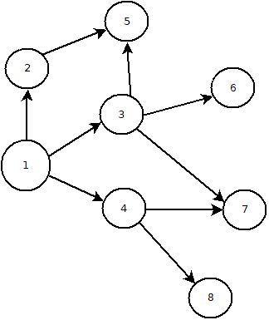
Efficient searching in infinite space
Graph expansion
Breadth first search

Slide 108
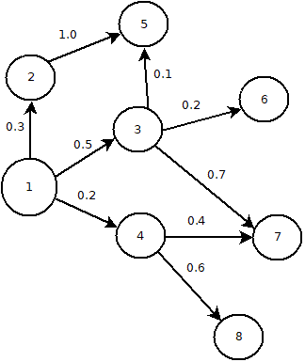
Efficient searching in infinite space
Graph expansion
Breadth first search
Best first search
Heuristics
Greedy algorithms

Slide 109

Efficient searching in infinite space
Graph expansion
Breadth first search
Best first search
Heuristics
Greedy algorithms
Applicability to MT
Graph of all possible sentences
Sentence probability as heuristic
Path dependence

Slide 110
Beam Search
Best first search potentially requires infinite memory
Bound memory by bounding size of the horizon
Beam size = number of unexpanded nodes
Expand best node → stack rank → apply beam size
Non-optimal solution
Softmax layer provides heuristic

Slide 111
What is P(f | e) ?

Slide 112
IBM Model 1
Noisy-channel translation f → e
Model: generative process e → f with P(f | e)
Sample a length m ∼ Q(m)
Distribution Q(m) doesn’t matter!
Sample an alignment {a_{i}} for i = 1,...,m
Sample a word f_{i} from t(f | e_{ai})
the
blue
house
NULL
m = 3

Slide 113
IBM Model 1
Noisy-channel translation f → e
Model: generative process e → f with P(f | e)
Sample a length m ∼ Q(m)
Distribution Q(m) doesn’t matter!
Sample an alignment {a_{i}} for i = 1,...,m
a_{i} ∼ Uniform(0, ℓ + 1)
a_{i} independent
Sample a word f_{i} from t(f | e_{ai})
the
blue
house
NULL
a₁ = 1
m = 3
Notes:
Note the NULL word we add to the source. This allows us to generate (crudely) spurious words in the target. We can always handle spurious source words by simply not aligning to them.

Slide 114
IBM Model 1
Noisy-channel translation f → e
Model: generative process e → f with P(f | e)
Sample a length m ∼ Q(m)
Distribution Q(m) doesn’t matter!
Sample an alignment {a_{i}} for i = 1,...,m
a_{i} ∼ Uniform(0, ℓ + 1)
a_{i} independent
Sample a word f_{i} from t(f | e_{ai})
the
blue
house
NULL
a₁ = 1
a₂ = 3
m = 3

Slide 115
IBM Model 1
Noisy-channel translation f → e
Model: generative process e → f with P(f | e)
Sample a length m ∼ Q(m)
Distribution Q(m) doesn’t matter!
Sample an alignment {a_{i}} for i = 1,...,m
a_{i} ∼ Uniform(0, ℓ + 1)
a_{i} independent
Sample a word f_{i} from t(f | e_{ai})
the
blue
house
NULL
a₁ = 1
a₂ = 3
a₃ = 2
m = 3

Slide 116
IBM Model 1
Noisy-channel translation f → e
Model: generative process e → f with P(f | e)
Sample a length m ∼ Q(m)
Distribution Q(m) doesn’t matter!
Sample an alignment {a_{i}} for i = 1,...,m
a_{i} ∼ Uniform(0, ℓ + 1)
a_{i} independent
Sample a word f_{i} from t(f | e_{ai})
t(f | e) tabulated
the
blue
house
NULL
la
m = 3
t(la | the)

Slide 117
IBM Model 1
Noisy-channel translation f → e
Model: generative process e → f with P(f | e)
Sample a length m ∼ Q(m)
Distribution Q(m) doesn’t matter!
Sample an alignment {a_{i}} for i = 1,...,m
a_{i} ∼ Uniform(0, ℓ + 1)
a_{i} independent
Sample a word f_{i} from t(f | e_{ai})
t(f | e) tabulated
the
blue
house
NULL
la
maison
m = 3
t(maison | house)

Slide 118
IBM Model 1
Noisy-channel translation f → e
Model: generative process e → f with P(f | e)
Sample a length m ∼ Q(m)
Distribution Q(m) doesn’t matter!
Sample an alignment {a_{i}} for i = 1,...,m
a_{i} ∼ Uniform(0, ℓ + 1)
a_{i} independent
Sample a word f_{i} from t(f | e_{ai})
t(f | e) tabulated
the
blue
house
NULL
la
maison
bleue
m = 3
t(bleue | blue)

Slide 119
IBM Model 1
the
blue
house
NULL
Noisy-channel translation f → e
Model: generative process e → f with P(f | e)
Sample a length m ∼ Q(m)
Distribution Q(m) doesn’t matter!
Marginalize alignment {a_{i}} for i = 1,...,m
a_{i} ∼ Uniform(0, ℓ + 1)
a_{i} independent
Sample a word f_{i} from t(f | e_{ai})
t(f | e) tabulated
la
maison
bleue

Slide 120

IBM Model 1: Inference
?
?
?
NULL
Noisy-channel translation f → e
Model: generative process e → f with P(f | e)
Closed-form expression for P(f | e)
As long as t(f | e) known
Alignments are implicit (summed out)
Use Bayes’ rule to compute P(e | f)
Decode using beam search over P(f | e) P(e)
la
maison
bleue

Slide 121

XLNet: Addressing BERT’s & GPT-2’s Problems
“Randomly permuted sequence factorization… what does that mean?”
Consider all permutation of input tokens
Predict a token (x₃ in example) based on preceding words in each permutation
“And that is good… why?”
Re BERT: No pre-training/fine-tuning mismatch (<MASK> used only in pre-training)
Re GPT-2: Learning from forward and backward context!
Source: ”XLNet: Generalized Autoregressive Pretraining for Language Understanding”, Yang et al, ,Enhanced LM - XLNet

Slide 122

Transformers still good with proper pre-training
Source: RoBERTa: A Robustly Optimized BERT Pretraining Approach

Slide 123
Implementation of Attention?
Generic Structure
Take Decoder output at time t-1: h_{t-1}^{(D)} (‘Query’)
“Compare” with all Encoder outputs : h_{i}^{(E)} (‘Keys’) to derive weights a_{i}(t-1)
Use weights to build weighted linear combination of Encoder outputs (‘Values’) for attention vector C(t-1) = ∑_{i} a_{i}(t-1) h_{i}^{(E)}
Use C(t-1) in computation of next Decoder step h_{t}^{(D)}
Questions
How do we compare (score)?
How do we use C’s?

